Slide 1
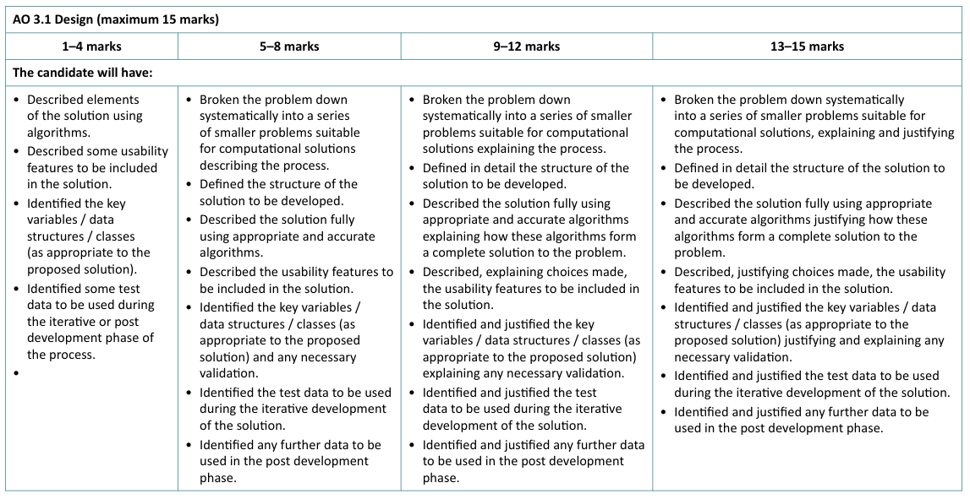
Design Phase

Slide 2
Decomposition
c) Describe the solution fully using appropriate and accurate algorithms justifying how these algorithms form a complete solution to the problem
Algorithms for all major functions
Write detailed pseudocode (or flowcharts) for every key modules.
Examples:
Account login
Searching records
Adding/editing/deleting data
Calculating results
Generating reports
The algorithms should be detailed enough that someone could code directly from them.

Slide 3
Algorithm
f) Identified and justified the test data to be used during the iterative development of the solution.
Example: Account Login
Flowchart | Pseudocode
 | INPUT username, password IF username and password match database THEN Grant Access ELSE Display error message ENDIF
Justify: This algorithm ensures only authorised users can access the system, meeting the security requirements identified in the analysis. Explain how algorithms connect together :The login algorithm authenticates the user before access is granted to the system. Once logged in, the booking algorithm allows users to create, edit and delete bookings, updating the database accordingly.
Input Username
Username = dbase name
Grant Access
Error

Slide 4
Iterative Testing
Example
ITERATIVE TESTING - Account Login
Module | Test Case | Test Data | Expected Outcome | Actual Outcome | Pass/Fail
Username Input | Valid username | John123 | Username accepted and program continues | Username accepted | Pass
Username Input | Blank username | "" | Error message displayed requesting username | Error displayed | Pass
Username Input | Invalid username format | John@123 | Error message displayed | Error displayed | Pass
Database Validation | SQL injection attempt (failed data test) | ' OR '1'='1 | Access denied, but input not fully sanitised | Access denied, but input not fully sanitised | Fail

